Slide 1
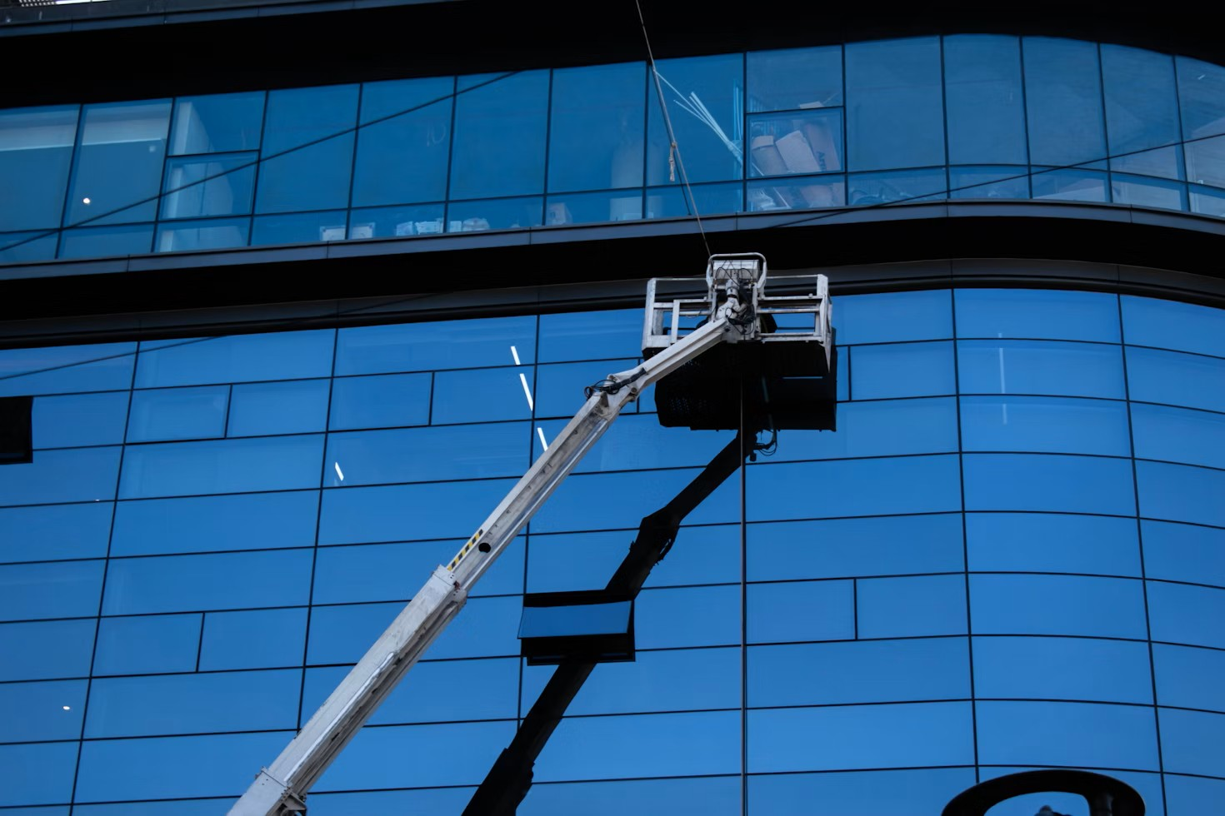
Investor Promotion
COMMUNI
Investor Promotion
Promotion Form
The promotion will be conducted in a 15 - minute English roadshow, consisting

Slide 2

Investor Promotion
COMMUNI
Introduction
Investor Promotion
Problem Analysis
Investor Promotion
CONTENTS
Solution Introduction
Investor Promotion
Market Analysis
Investor Promotion

Slide 3
Investor Promotion
COMMUNI
01
Introduction
The promotion will be conducted in a 15 - minute English roadshow, consisting
PART ONE

Slide 4

Investor Promotion
COMMUNI
Promotion Form
Presentation Format
Service 03
The promotion will be conducted in a 15 - minute English roadshow, consisting of a 10 - minute presentation followed by a 5 - minute Q&A session, aiming to effectively convey the project's value to investors.
The target audience includes international angel/seed
Service 03
Service 03
The core goal is to secure a $2 million seed - round
The project is named 「EcoCrate」, an EU - based

Slide 5
Investor Promotion
COMMUNI
What our customers say
The slogan 「We turn cardboard waste into circular cash.」 clearly reflects the project's innovative business model and environmental - economic dual - benefit concept.
Financing Details

Slide 6

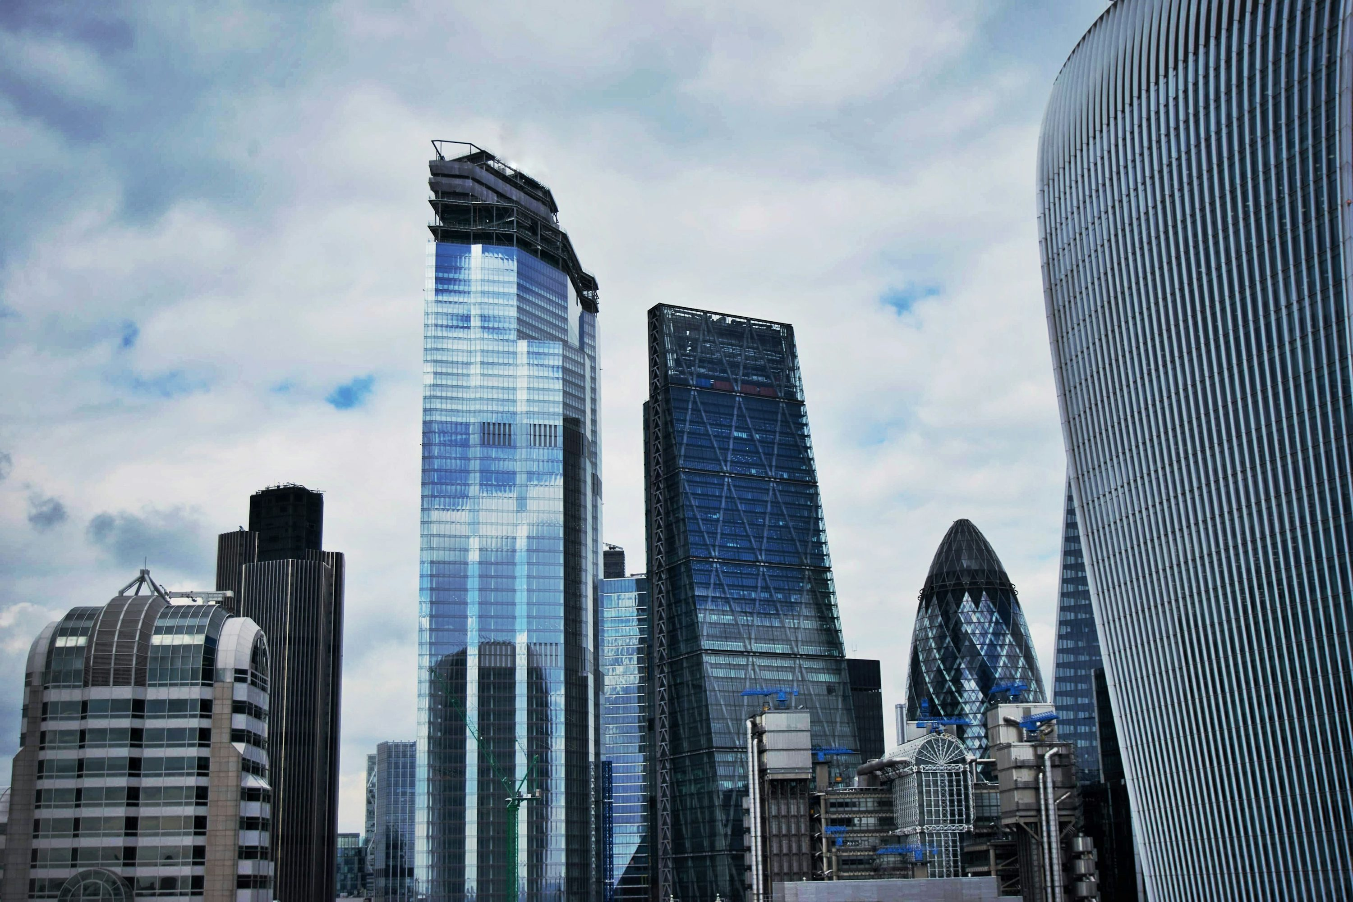
Investor Promotion
COMMUNI
Investment Target
The core objective is to secure a $2 million seed - round investment by offering 15% equity, with an 18 - month runway. This investment will fuel the growth of the startup and help it achieve its short - and medium - term goals.
The target audience includes international angel/seed funds like Y Combinator, Seedcamp, Techstars, and industry investors. These entities have the resources and expertise to support the startup's development.
Female
Male
40%
60%

Slide 7
Investor Promotion
COMMUNI
02
Analysis
The promotion will be conducted in a 15 - minute English roadshow, consisting
PART TWO

Slide 8
Investor Promotion
COMMUNI
Product Analysis
Product Analysis Details here
During the presentation, the presenter will hold up a flattened cardboard box, stating that this box, with an average lifespan of only 14 days, requires the resources of 7 trees, which is a shocking fact to draw investors' attention.
$186K
%52.08+
%48.02-
$257K

Slide 9
Investor Promotion
COMMUNI
Impact on Attention
Striking Data
These props and data are designed to create a strong visual and numerical impact, immediately locking in the investors' attention at the beginning of the presentation.
?
Live Prop
Striking Data
In 2023, the global e - commerce packaging waste
In 2023, the global e - commerce packaging waste

Slide 10


Investor Promotion
COMMUNI
Obtaining Commitments
50
%
The goal is to get immediate commitments such as POC, budget confirmation
This presentation is designed for international SaaS
30
%
Establishing Trust
In a 30 - minute presentation, aim to build “business - technology - finance” triple trust with the audience
This presentation is designed for international SaaS

Slide 11
Investor Promotion
COMMUNI
03
Solution
The promotion will be conducted in a 15 - minute English roadshow, consisting
PART THREE

Slide 12
Investor Promotion
COMMUNI
Credibility Building
Foundation for Success
Industry Benchmarking
Identifying Trends
A strong start lays the foundation for a successful presentation, increasing the likelihood of obtaining the desired commitments from the audience.
It helps build the credibility of the presenter and the company, as it shows professionalism and preparedness.

Slide 13

Investor Promotion
COMMUNI
Market Analysis
Market Trends
There is an increasing demand for fresh groceries delivered quickly and efficiently. Consumers are also more conscious of the environmental impact of their purchases, driving the need for sustainable fulfillment solutions
The global fresh grocery e - commerce market (TAM) is valued at $477 B, with a Compound Annual Growth Rate (CAGR) of 18% from 2023 - 2028 (Statista, 2024). This indicates a large and growing market opportunity.
Market Challenges
High fulfillment costs and last - mile delivery issues are major challenges in the fresh grocery e - commerce industry. Our solution aims to address these pain points effectively

Slide 14
Investor Promotion
COMMUNI
Revenue Streams
Financial Metrics
The Total Addressable Market (TAM) for the global reusable packaging market
The business model is based on Reusables - as - a - Service (RaaS)
The Serviceable Available Market (SAM) for EU e - commerce and 3PL reusable
The LTV/CAC ratio is 4.1, and the payback period is 9 months, indicating a healthy
The startup aims to capture 5% of the market in the first year, targeting an initial
The startup will use a 3PL alliance and a Shopify App to reach cross - border sellers

Slide 15
Investor Promotion
COMMUNI
04
Market
The promotion will be conducted in a 15 - minute English roadshow, consisting
PART FOUR

Slide 16
Investor Promotion
COMMUNI
International
Customer Pain Points
The sales strategy is primarily targeted at international B2B customers, specifically the procurement
Customers face issues like high cross - regional order fulfillment costs (more than 8% of revenue compared to the industry best of ≤4%)
Market Scope
Target Audience
These customers are crucial for achieving the goal of locking in POC or annual prepaid contracts worth at least $1.2M ARR.
and ESG audit non - compliance with potential EU EPR fines of €35k/year.

Slide 17
Investor Promotion
COMMUNI
Our style
User Experience Design
Simplicity and Ease of Use
The user experience design of AI products should focus on simplicity and intuitiveness, reducing the user's learning cost. A clean and straightforward interface can make it easier for users to operate the product and quickly achieve their goals.
Establishing an effective user feedback mechanism is crucial. It allows the brand to promptly respond to users' questions and suggestions, continuously improving the product based on user input.
Personalization Feature

Slide 18
Investor Promotion
Brand Ecosystem Building
Building an open platform can attract developers and partners. It provides a space for innovation and collaboration, allowing different parties to contribute to the growth of the brand's ecosystem.
Setting up an app store with a wide range of AI applications and plugins can increase the product's attractiveness
Project 20XX
AI Product

Slide 19
Search
Business Overview
COMMUNI
THANK YOU
BUILD YOUR FUTURE
The promotion will be conducted in a 15 - minute English roadshow, consisting

